Slide 1
ABS, ESP, TCS
Anti-lock break system
Electronic stability program
Traction Control System

Slide 2
Introduction to Friction
Friction is a force that always exists between any two surfaces in contact with each other and resists their relative motion
There are two kinds of friction, based on how the two surfaces are moving relative to each other:
  Static friction
  The friction that exists between two surfaces that are not moving relative to each other.
  Kinetic friction (Sliding Friction)
  The friction that exists between two surfaces that are moving relative to each other.
In any situation, the static friction is greater than the kinetic friction.
  Nobody is exactly sure why friction acts the way it does…
    Some physicists’ theories on friction involve the idea of the minute (tiny) imperfections in the surfaces grinding against each other.
    There is also the hypothesis that there are small electrostatic attractions between atoms of the two surfaces, pulling on each other.

Slide 3
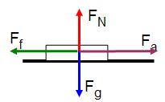
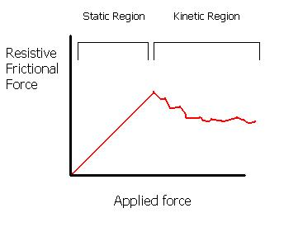
Friction (Part 2)
F_{f} = force due to friction (Newtons)
F_{N} = normal force (Newtons)
μ = Greek letter “mu”, coefficient of friction between two surfaces (no units)
μ_{s} is static, μ_{k} is kinetic
F_{f} = μ F_{N}
Surfaces | µ (static) | µ (kinetic)
Steel on steel | 0.74 | 0.57
Glass on glass | 0.94 | 0.40
Metal on Metal (lubricated) | 0.15 | 0.06
Ice on ice | 0.10 | 0.03
Teflon on Teflon | 0.04 | 0.04
Tire on concrete | 1.00 | 0.80
Tire on wet road | 0.60 | 0.40
Tire on snow | 0.30 | 0.20

Slide 4
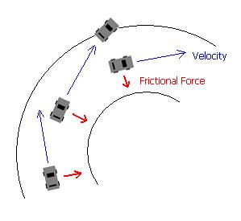

Friction relation to automobiles
Braking distance can be calculated using the equation
d = V² / 2gµ $Vmax=\sqrt{μ g r}$
Where:
d = Braking Distance
g = Acceleration due to gravity (9.80 m/sec²)
Vmax- Maximum velocity
r- Raddius of curve
V = Initial vehicle speed (m/sec)
µ = Coefficient of friction between the tires and the roadway
It is better, for your tire to be using static friction rather than kinetic friction.
  If the tire is rolling along so that the surface touching the ground is never sliding, then static friction is acting to slow the car.
  If the wheels are locked and sliding, then kinetic friction is acting to slow the car.
Options:
  apply just enough brake to stay within the static range of friction and not too much to lock the tires
  pumping the brake, which has the effect of alternating the use of kinetic and static friction as the wheels lock and unlock
  Give your car take care of the braking for you

Slide 5
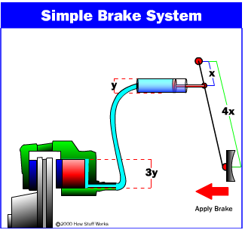
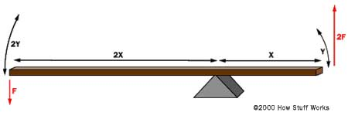
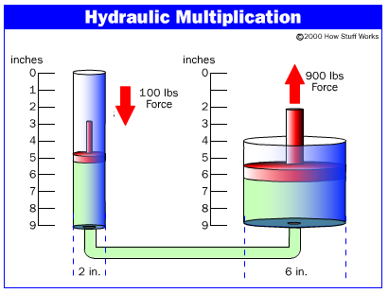
How Breaks in vehicle (usually)works
The brakes transmit the force which applied to braking pedal to the tires using friction, and the tires transmit that force to the road using friction also.
Several topics behind the scene:
  Leverage
  Hydraulics
  Friction

Slide 6
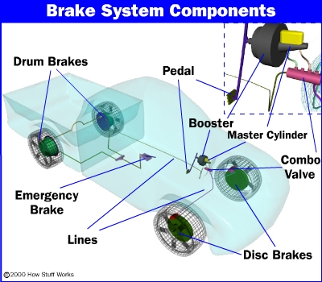
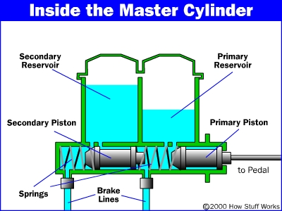
How Breaks in vehicle (usually)works
T­o increase safety, most modern car brake systems are broken into two circuits, with two wheels on each circuit.
If a fluid leak occurs in one circuit, only two of the wheels will lose their brakes and car will still be able to stop.
The master cylinder supplies pressure to both circuits of the car It uses two pistons in the same cylinder in a way that makes the cylinder relatively failsafe.
The Combination valve does the job of two separate devices:
  The pressure differential switch
    alerts you if you have a leak in one of your brake circuits
  The proportioning valve
    reduces the pressure to the rear brakes.

Slide 7
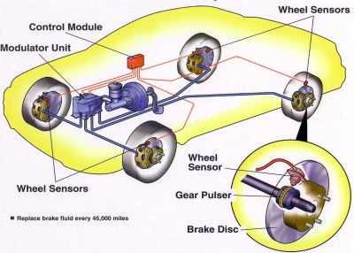
Finally ABS
Anti-lock braking system (ABS) is an automobile safety system that allows the wheels on a motor vehicle to maintain tractive contact with the road surface according to driver inputs while braking,
ABS was first developed for aircraft use in 1929 by the French company Gabrier Voisin
There are four main components to an ABS system:
  Speed sensors (Usually One on each wheel )
  Pump (Usually included into Modulator)
  Valves (Usually included into Modulator)
  Controller

Slide 8
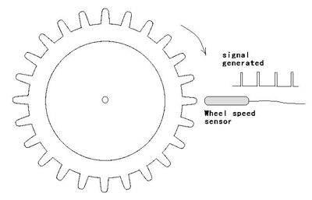
Speed sensor
Wheel Speed Sensors measure the road-wheel speed and direction of rotation
Wheel speed sensors typically include a toothed (or optically encoded) shaft and a magnetic (or optical) sensor.
The sensor counts the rate at which the teeth or marks pass by
There are two types of magnetic sensors:
  Variable reluctance
  Hall effect.
The ABS control unit receives the low AC voltage (Frequency modulation) from these sensors which increases with wheel speed. It then compares these values to the values it has stored in its memory.

Slide 9

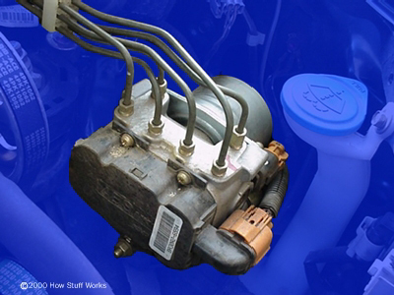
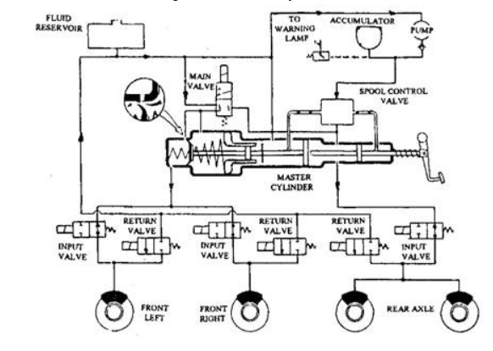
VALVES PUMP CONTROLLER
Valves
  There is a valve in the brake line of each brake controlled by the ABS. On some systems, the valve has three positions:
    In position one, the valve is open; pressure from the master cylinder is passed right through to the brake.
    In position two, the valve blocks the line, isolating that brake from the master cylinder. This prevents the pressure from rising further should the driver push the brake pedal harder.
    In position three, the valve releases some of the pressure from the brake.
Pump
  The pump is getting pressure back to the line after a valve reduces the pressure and wheel was unreleased.
Controller
  The controller is a computer in the car. It watches the speed sensors and controls the valves.

Slide 10
Types of ABS Systems
Four-channel, four-sensor ABS
  There is a speed sensor on all four wheels and a separate valve for all four wheels. With this setup, the controller monitors each wheel individually to make sure it is achieving maximum braking force.
Three-channel, three-sensor ABS
  This scheme, commonly found on pickup trucks with four-wheel ABS, has a speed sensor and a valve for each of the front wheels, with one valve and one sensor for both rear wheels. The speed sensor for the rear wheels is located in the rear axle.
One-channel, one-sensor ABS
  This system is commonly found on pickup trucks with rear-wheel ABS. It has one valve, which controls both rear wheels, and one speed sensor, located in the rear axle.

Slide 11
Simplest algorithm
When the driver applies breaking The controller monitors the speed sensors at all times. (looking for decelerations in the wheel that are out of the ordinary).
Controller reduces the pressure to that brake until it sees an acceleration,
  Putting the valve In position three,( the valve releases some of the pressure from the brake.)
  After it puts valves in position two,(the valve blocks the line, isolating that brake from the master cylinder)
Then it increases the pressure in the systemuntil it sees the deceleration again.
  Putting the valve In position In position one, the valve is open; pressure from the master cylinder is passed right through to the brake.
Repeat this procedure around 15 times per second
When the ABS system is in operation driver feels l a pulsing in the brake pedal;.
https://www.youtube.com/watch?time_continue=407&v=98DXe3uKwfc&embeds_referring_euri=https%3A%2F%2Fwww.google.com%2F
Notes:
1)Right before a wheel locks up, it will experience a rapid deceleration. If left unchecked, the wheel would stop much more quickly than any car could. It might take a car five seconds to stop from 60 mph (96.6 kph) under ideal conditions, but a wheel that locks up could stop spinning in less than a second
Rapid deceleration of a wheel is impossible

Slide 12
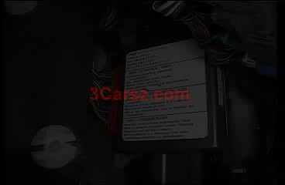

Slide 13
TCS (Traction Control System )
TCS ensures that the wheels do not spin when driving off or accelerating.
To do this, the drive torque at each driven wheel is reduced correspondingly.
TCS improves the traction of the vehicle and increases vehicle safety by avoiding unstable driving situations within the limits of physics.
Traction control helps limit tire slip in acceleration on slippery

Slide 14
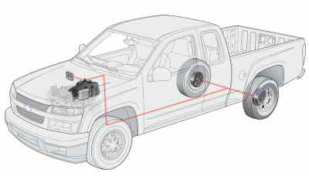
How TCS works
How it works: TCS supplements the ABS function.
  Sensors
  Valves
  Pump
Sensors measure differences in rotational speed to determine if the wheels that are receiving power have lost traction all the time .
If one of the driven wheels tend to spin, TCS is activated.
When the traction-control system determines that one wheel is spinning more quickly than the others, it automatically "pumps" the brake to that wheel to reduce its speed and lessen wheel slip.
Some traction-control systems also reduce engine power to the slipping wheels.
In a few of these vehicles, drivers may sense pulsations of the gas pedal when the system is reducing engine power much like a brake pedal pulsates when the antilock braking system is working.

Slide 15

TCS

Slide 16
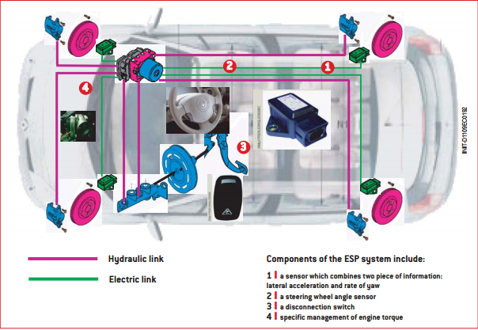
ESP (Electronic stability program)
Dynamic trajectory control, also known as ESP (Electronic Stability Program),assists the driver to retain control of his vehicle in the event of a loss of grip
The aim of ESP is to maintain the trajectory of the vehicle
Traction control operates alongside ESP
ESP uses ABS as a basement with additional sensors
  Lateral acceleration sensor
  Gyrometer
  Steering wheel angle sensor

Slide 17
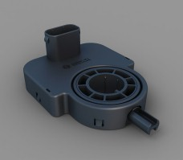
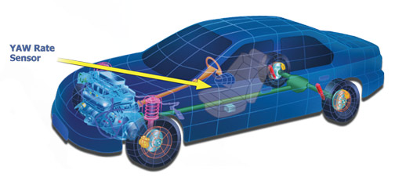
Sensors:
Steering wheel
  The task of the steering-angle sensor is to measure the position of the steering wheel by determing the steering angle. From the steering angle, the vehicle speed and the desired braking pressure or the position of the accelerator pedal, the driving intention of the driver is calculated (desired state).
Yaw Rate Sensor (Gyrometr and Lateral acceleration sensors)
  A yaw-rate sensor registers all the movements of the vehicle around its vertical axis. In combination with the integrated lateral-acceleration sensor, the status of the vehicle (actual state) can be determined and compared with the driver´s intention.

Slide 18
How does it work?
ESP works selectively on each wheel and, if necessary, on engine torque.
ESP analyses the data provided by seven sensors (always)and compares them with a reference model of the vehicle’s behavior stored in its memory
Computer determines the speed of the vehicle by analysing the data provided by each wheel’s tachometers
Computer also checks that the difference in speed of rotation between the right and the left wheels conforms to the bend that vehicle is negotiating
The analysis is further refined by data supplied by a sixth sensor, a gyrometer, which detects the vehicle's rotational movements around its vertical axis
Accelerometer enables it to detect the onset of lateral slipping
If Any discrepancy detected by the computer results from a deviation between the car’s real trajectory and that desired by the driver
The computer then acts selectively, applying brakes to one or more wheels.
If the selective braking of wheels is insufficient to force the vehicleto adopt the correct trajectory, the computer then acts on engine torque

Slide 19
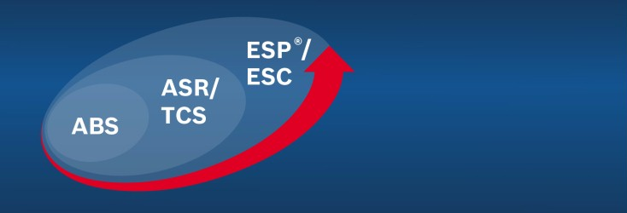
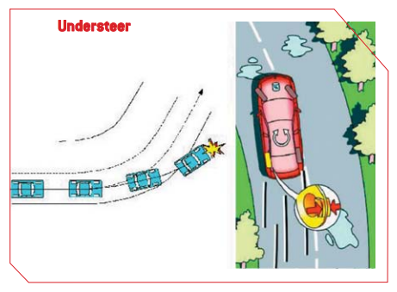
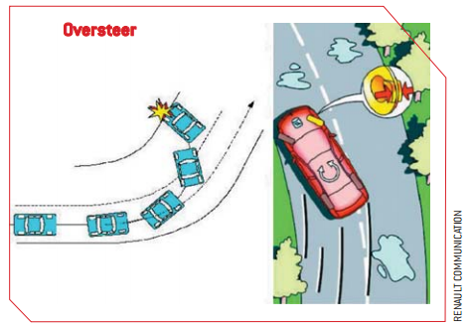
Exampled

Slide 20

ESP

Slide 21
Moderni pridavaji krutici moment…. Pokud najdes info…
  Torgue controll

